Slide 1
Research methodology
Phase 1
Literature Review
Phase 2
Analysis of each of the tools and the scope of the project.
Phase 3
Network and Software Implementation.
Phase 4
Platform validation and evaluation
Phases
Planning methodology
Establishment criteria in the project.
First design with constrains
Testing platform
Stages
Documentation
Design Benchmark
Analysis of data
Error correction
Results
Development Benchmark
Data presentation [Dashboard]
Final version
Keywords: Anomalies, Network LoRa, IA, Kafka – Spark Streaming, Communication BLE

Slide 2

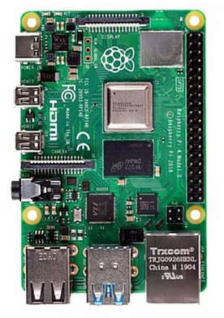
Client Device – Acquisition System
Server Device – Acquisition System
Raspberry Pi
(Processing unit)
Raspberry Pi
(Processing unit)
Wire conecction
Sensing module
Data aggregation
Socket Module
BLE
Socket Module
Data aggregation
Sending Data
LoRa
Devices
Python
Python

Slide 3



Data Treatment
Database
Data
Received
Data Trasnmision
Input Data Stream
Spark Engine
Batches of processed data
Batches of input data
Dashboard

